Slide 1
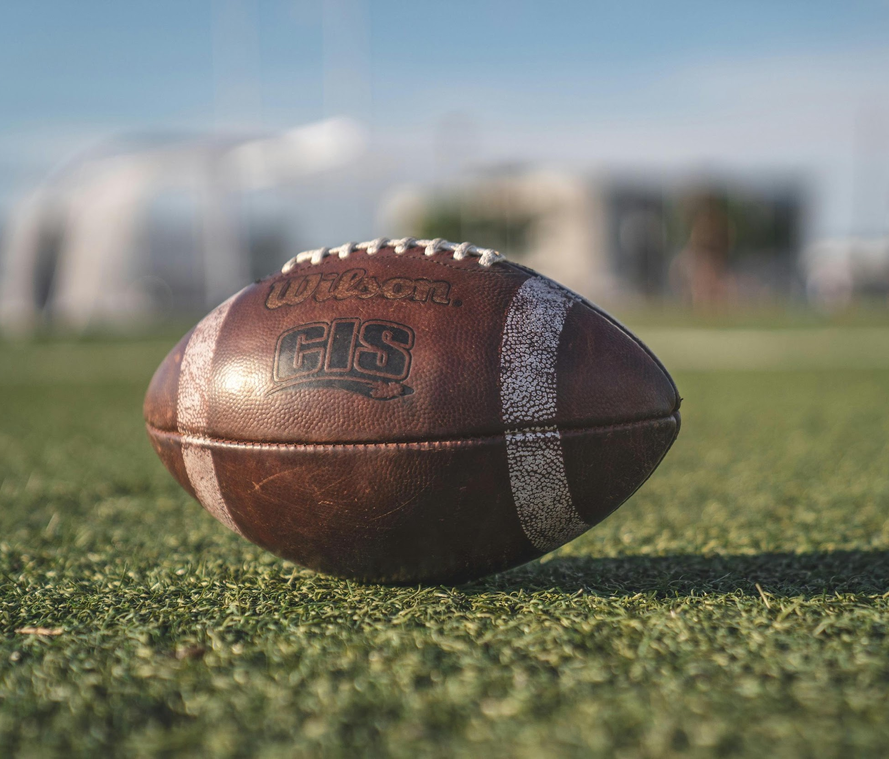
P3: Finding an Edge in Sports Betting
Team E – Joseph Schoenbaum and Gabriel Kuykendall

Slide 2
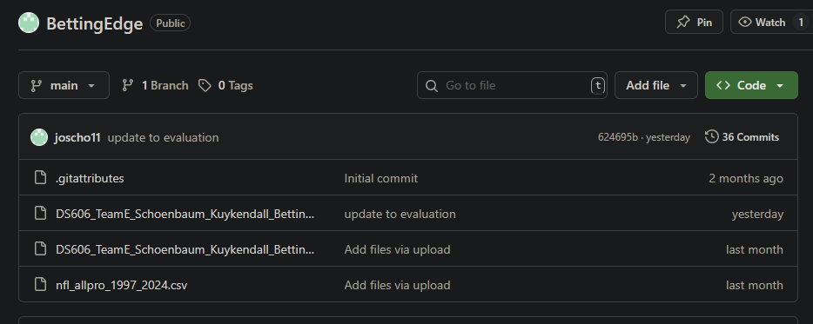
GITHUB FOR OUR PROJECT
https://github.com/joscho11/BettingEdge

Slide 3
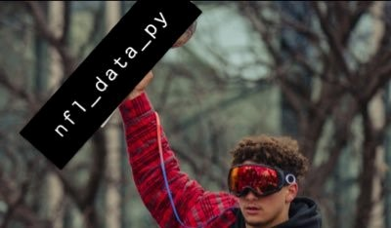
Dataset
nfl_data_py - https://github.com/nflverse/nfl_data_py
Spread line data - https://www.kaggle.com/datasets/tobycrabtree/nfl-scores-and-betting-data?select=spreadspoke_scores.csv
Other Features - https://www.pro-football-reference.com/

Slide 4
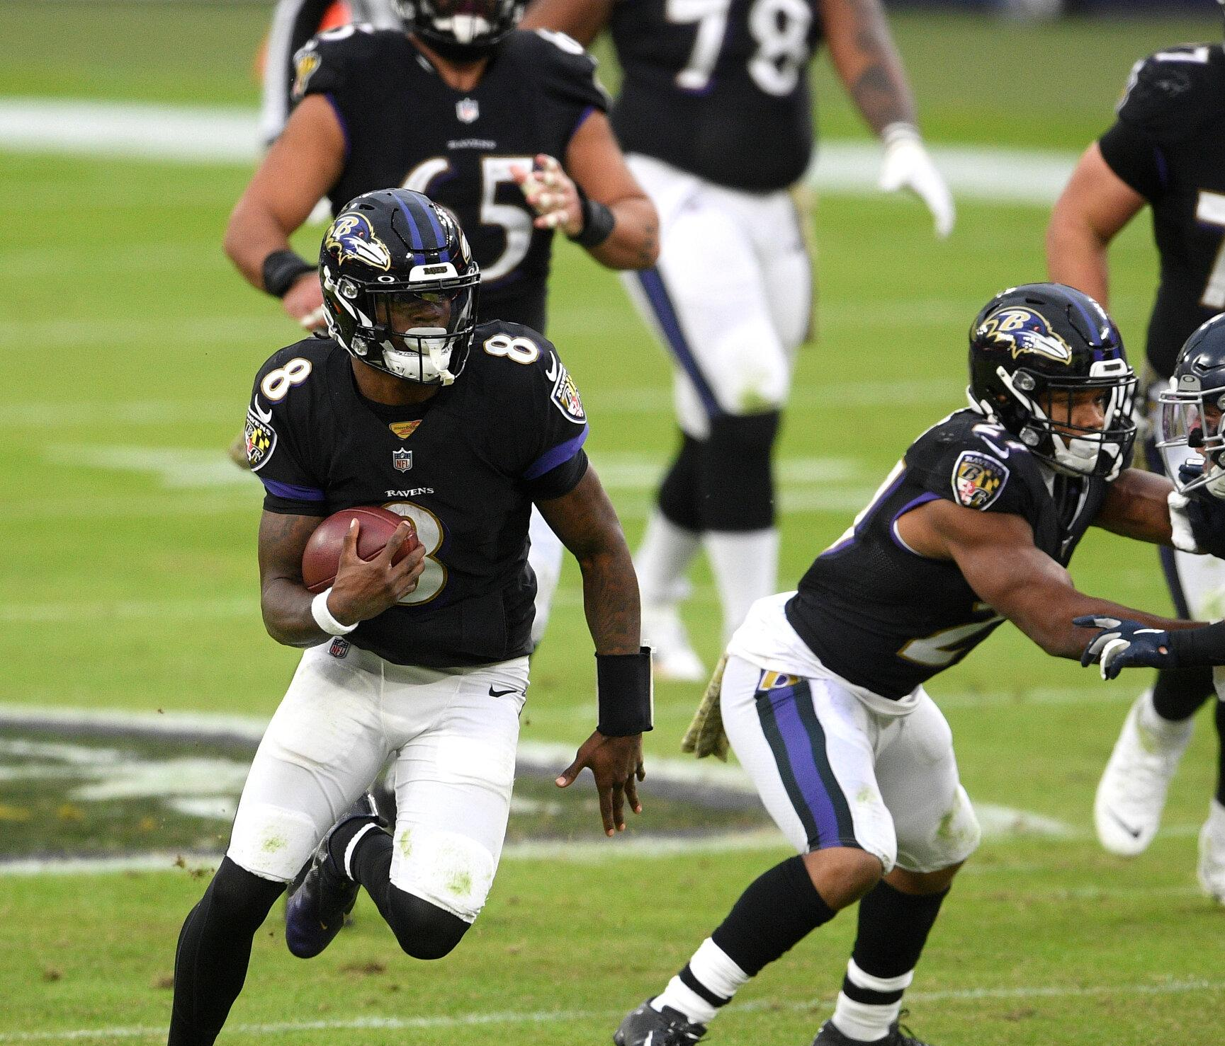
Overview
Refresher on Project
EDA
Modeling
Evaluation
Conclusion
References
Q&A

Slide 5
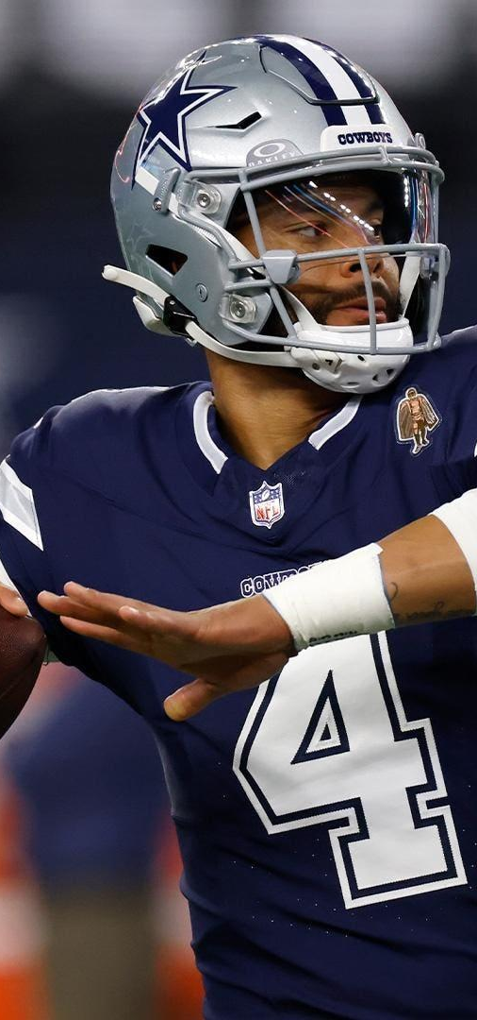
Project Refresher
Using different match related features, create several models to predict the score difference in NFL games
Compare our new spreads to existing spreads
Determine the effectiveness our spreads in improving the earnings of bettors

Slide 6
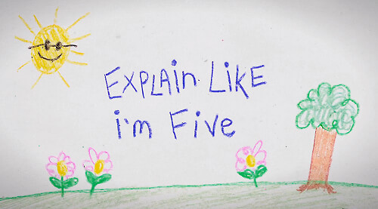
ELI5 – Sports Betting
Ex: if the Patriots are supposed to win by 3 points over the Colts then the spread would be Patriots -3 which is equal to Colts +3
Let's say the end of game result is Patriots win 27-21. This means to win the bet we would've had to say (before the game starts) that the Patriots are going win by more than 3 points. That would qualify as a winning bet
NOTE - it does not matter how much the Patriots win by as long as they win by more than 3 points. If they win by 50 points or 3 points we still win the bet

Slide 7
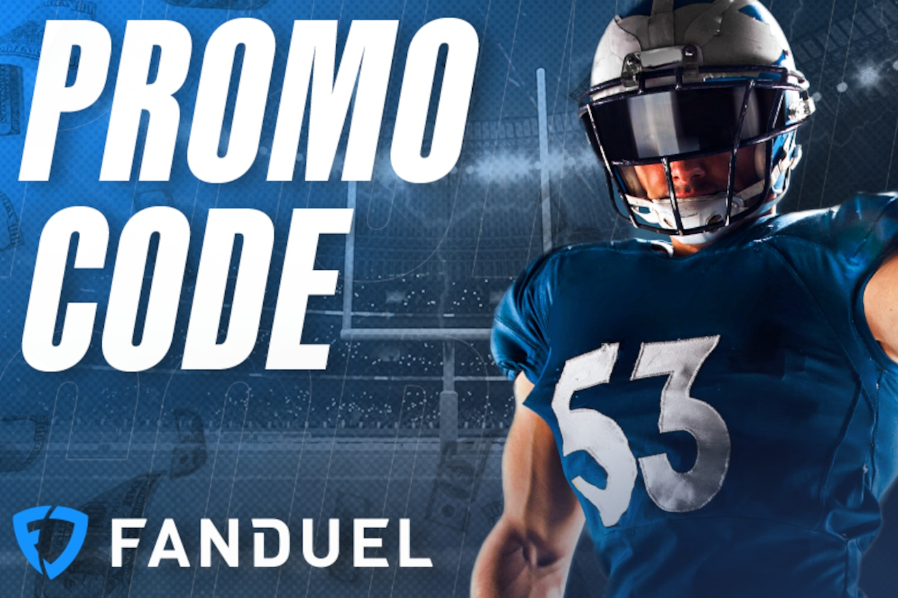
Goal of our Project
Ca model that has a spread bet winning percentage above 52.4%
To break-even in sports betting, at standard odds of -110 (meaning you risk $11 to make $10), you need to win around 52.4% or more of your bets
Sportsbooks charge a fee on every bet you place that is around 4.2% (this can vary depending on the bet and sportsbook)
The problem is sports are very noisy and hard to predict
In addition, our model is competing with a Sportsbooks and their model which has infinitely more resources

Slide 8
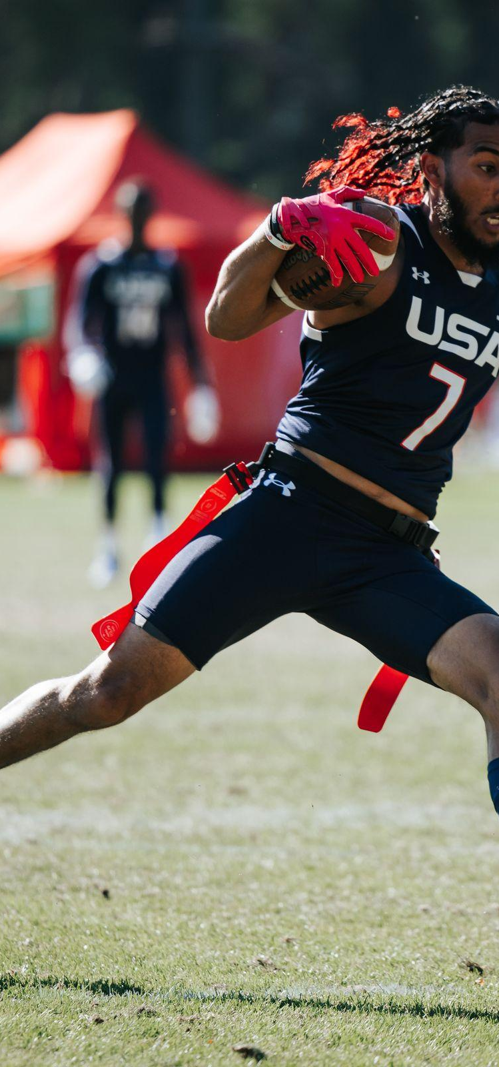
Dataset information
For our project we will be using data from a python library called nfl_data_py
nfl_data_py is a Python library for interacting with NFL data sourced from Kaggle, nflfastR, nfldata, dynastyprocess, and Draft Scout
Includes import functions for play-by-play data, weekly data, seasonal data, rosters, win totals, scoring lines, officials, draft picks, draft pick values, schedules, team descriptive info, combine results and id mappings across various sites
Our project will use game data from 2009 to 2025
Ex: each row will include information about an event – 02/09/25 - Kansas City Chiefs vs Philadelphia Eagles (22 – 40)
Original dataset
4345 rows and 46 columns
Link to library - https://pypi.org/project/nfl-data-py/
Link to github of library - https://github.com/nflverse/nfl_data_py/tree/main
Various add-on features were taken from https://www.pro-football-reference.com/

Slide 9
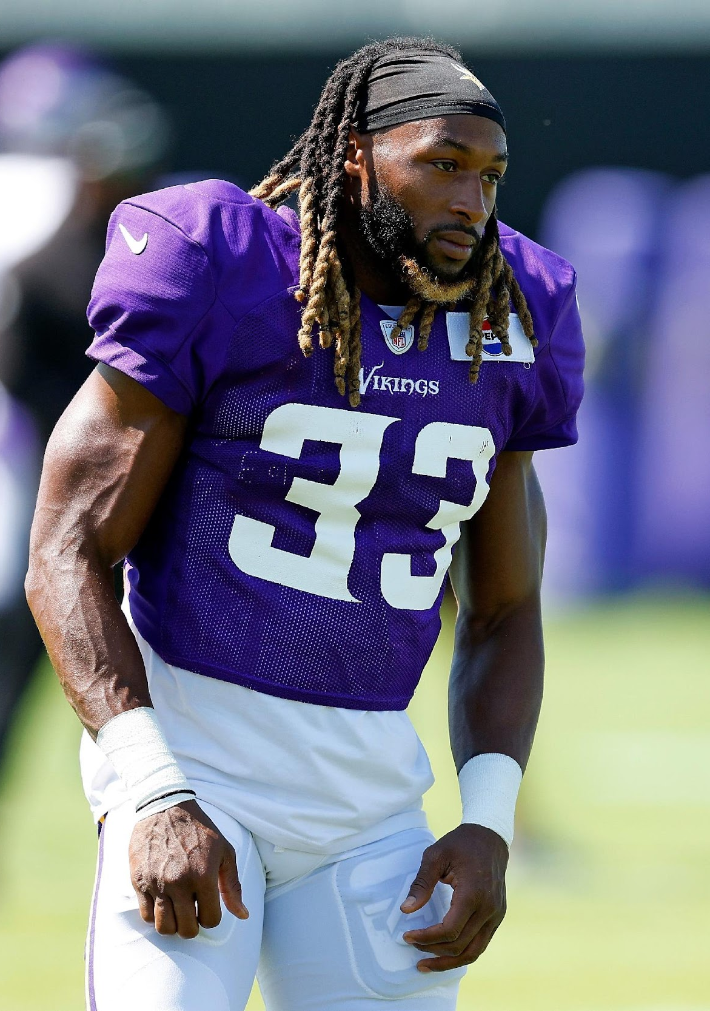
Similar Projects
https://www.kaggle.com/code/dubradave/nfl-injuries-grass-vs-fieldturf
Used nfl_data_py to evaluate injuries based on field type
https://www.kaggle.com/code/twalters20/nfl-betting-model#Feature-and-Model-Testing
Created a betting model to determine if the favored team would cover the spread

Slide 10
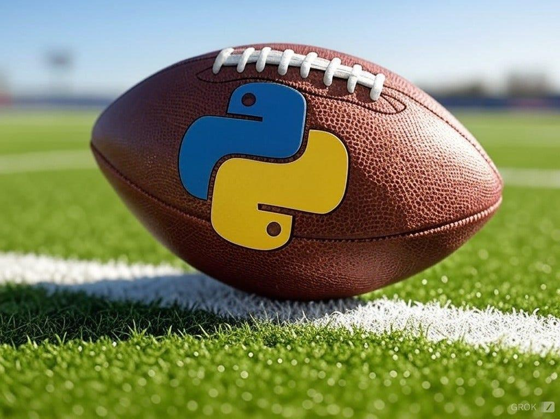
Similar Projects Cont.
https://python.plainenglish.io/using-python-to-mimic-nfl-sportsbook-odds-determination-2d96dc84ecab
Used multiple NFL datasets including nfl_data_py in order to replicate Vegas Odds for NFL games
Used a linear regression model
Results were evaluated against the actual Vegas Spread and saw positive correlation between the model and actual Spreads

Slide 11
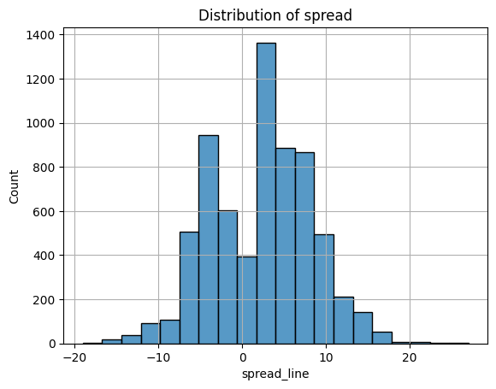
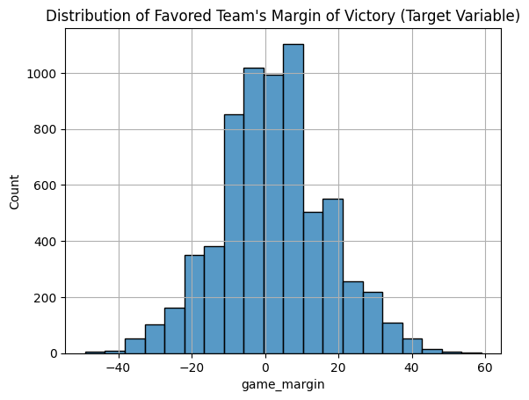
EDA
Distribution of target variable (game margin)
Distribution of spread line
As you can see game_margin has about the double the range of spread_line

Slide 12
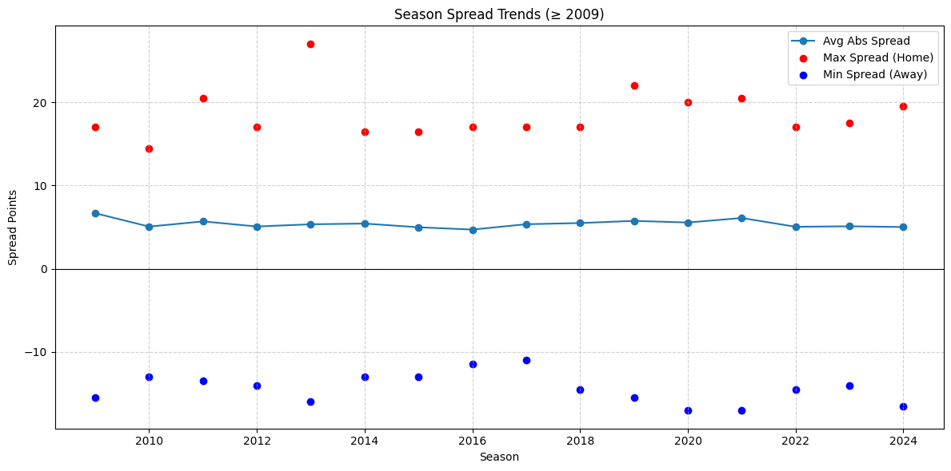
Spread EDA Cont.

Slide 13
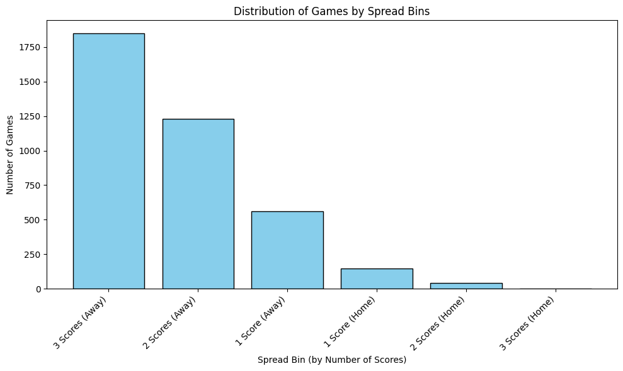
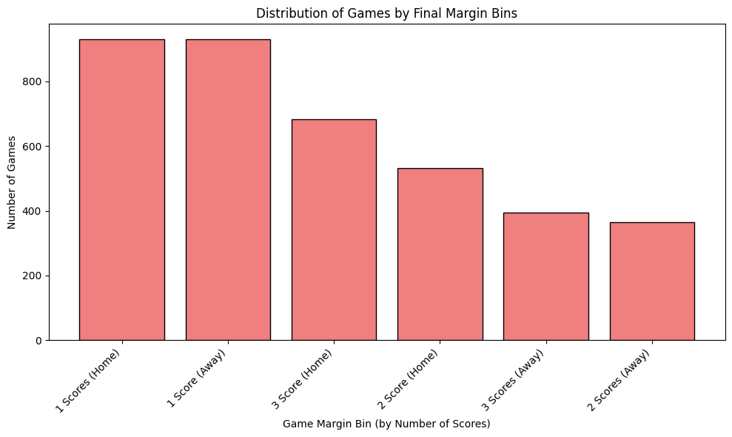
Spread EDA Cont.

Slide 14
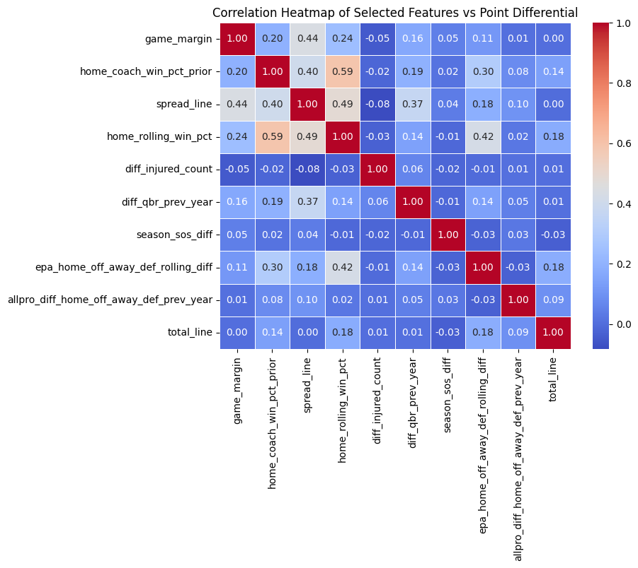
Heatmap on Key Features
As you can see even the most impactful features do not show much correlation
The spread_line shows the most correlation to game_margin at 44%
Other notable features include coach winning percentage, winning percentage, quarterback rating, and expected points added
All features included in our models only include values prior to the event

Slide 15
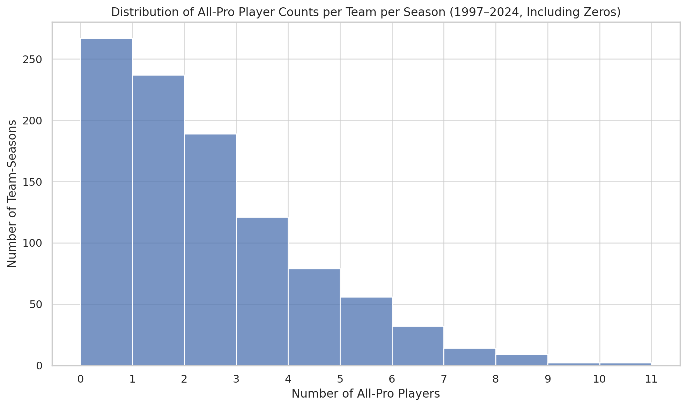
All-Pro EDA

Slide 16
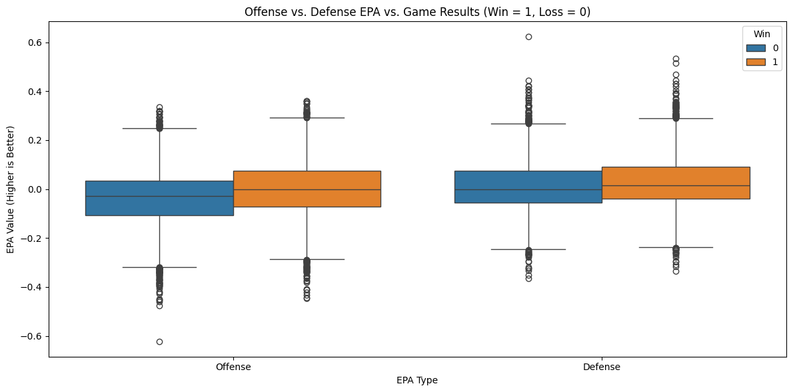
EPA EDA

Slide 17
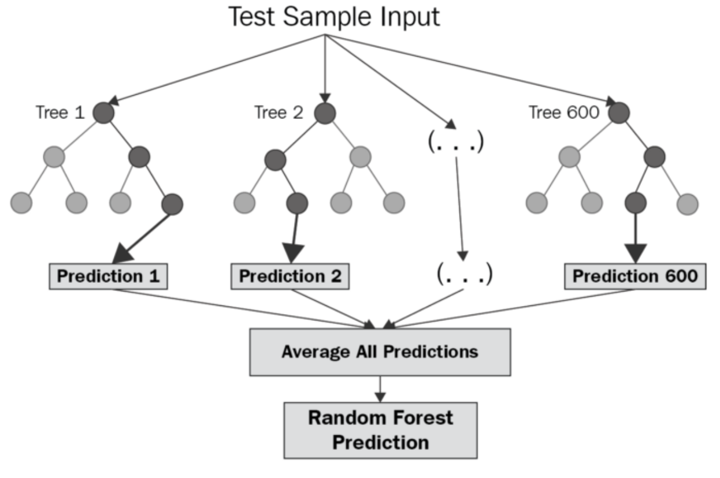
Random Forest Regressor
Why use a random forest regressor?
handles nonlinear data well
works well with a broad range of features
Is less prone to overfitting
Allows for feature importance

Slide 18
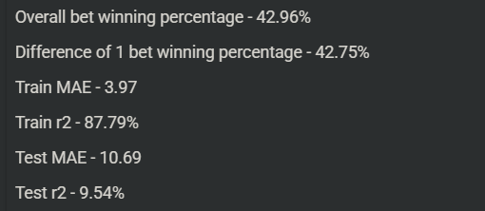
1st Iteration of the Model
All 90 features, no hyperparameter tuning
Takeaway – Clear overfitting to training data
32 features with less than 0.5% importance

Slide 19
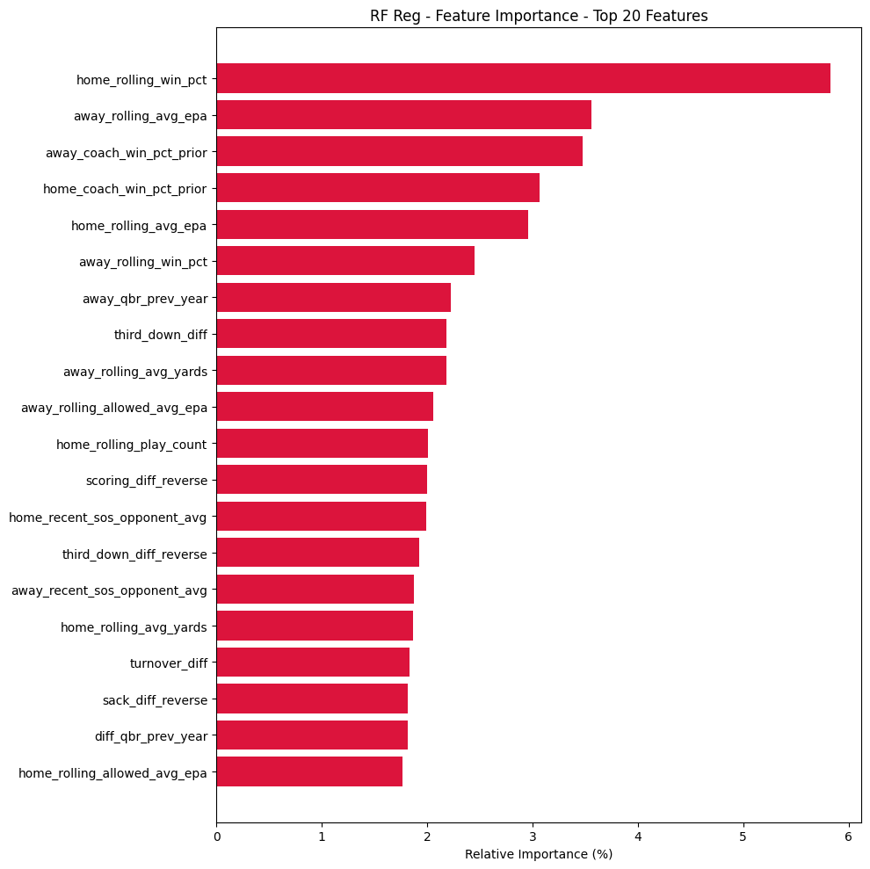

Slide 20
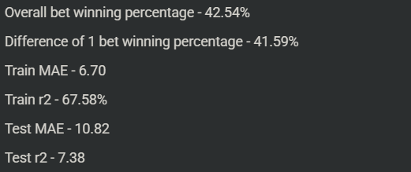
2nd Iteration of Model
Removed redundant features, leaving 44 features
adding max depth
Takeaway – Decreased overfitting, slightly worse performance

Slide 21
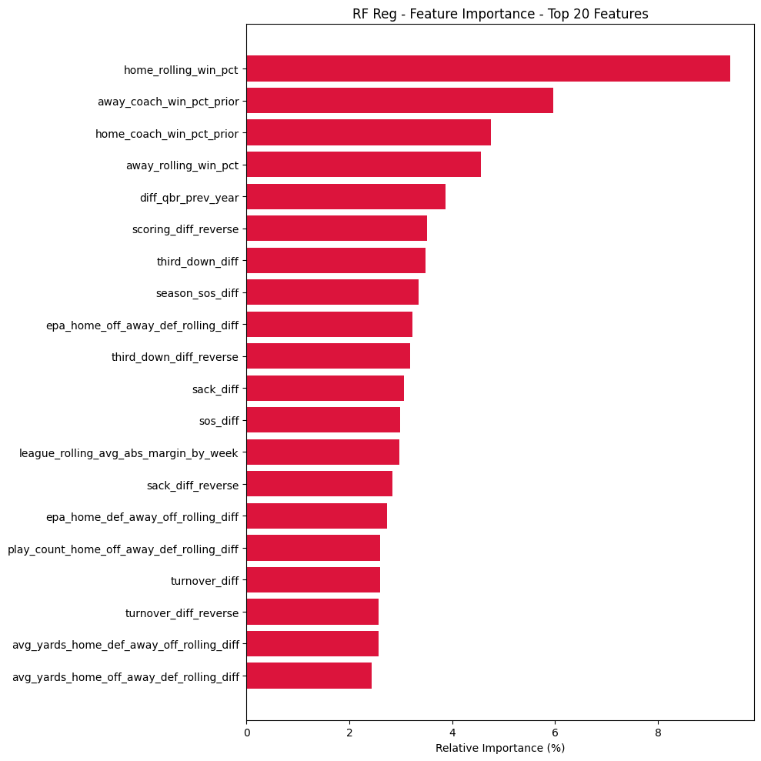

Slide 22
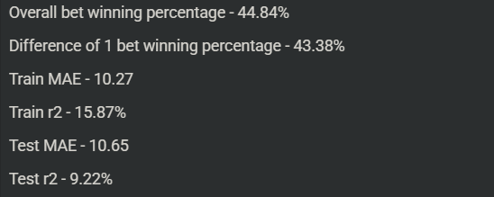
3rd Iteration of Model
Removed features with less than 1% importance from 2nd iteration model – leaving 31 features
Using more hyperparameter tuning w/ GridSearch and Include Cross-validation
Takeaway – Underfitting training data, Performance not as good as 1st iteration, but similar (or slightly better) than the model from iteration 2.

Slide 23
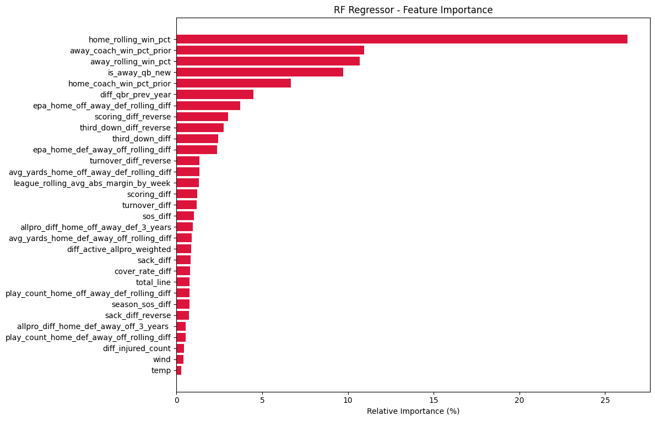

Slide 24
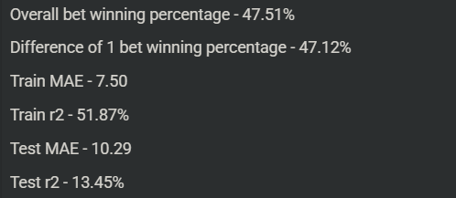
4th Iteration of Model
1st iteration (all features) w/ hyperparameter tuning
Takeaway:
Hyperparameter tuning was critical to reduce overfitting
Unsurprisingly, keeping all features gives the best results

Slide 25
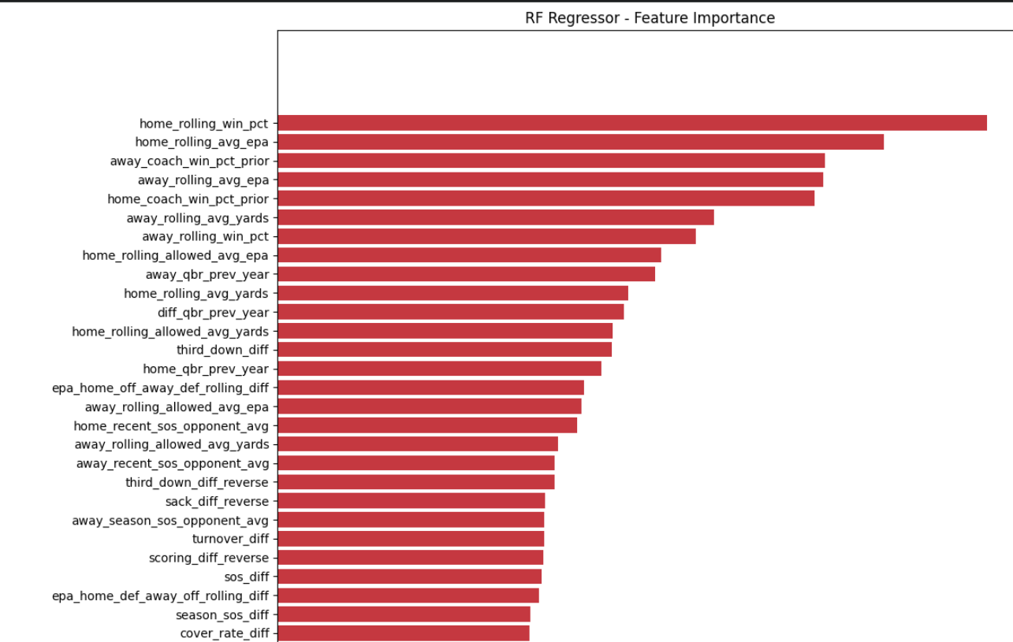

Slide 26
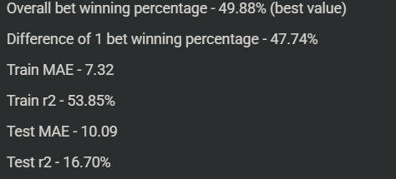
5th and Final Iteration
4th iteration model with spread line included as a feature
Takeaway – Adding the spread line as a feature improves the model slightly

Slide 27
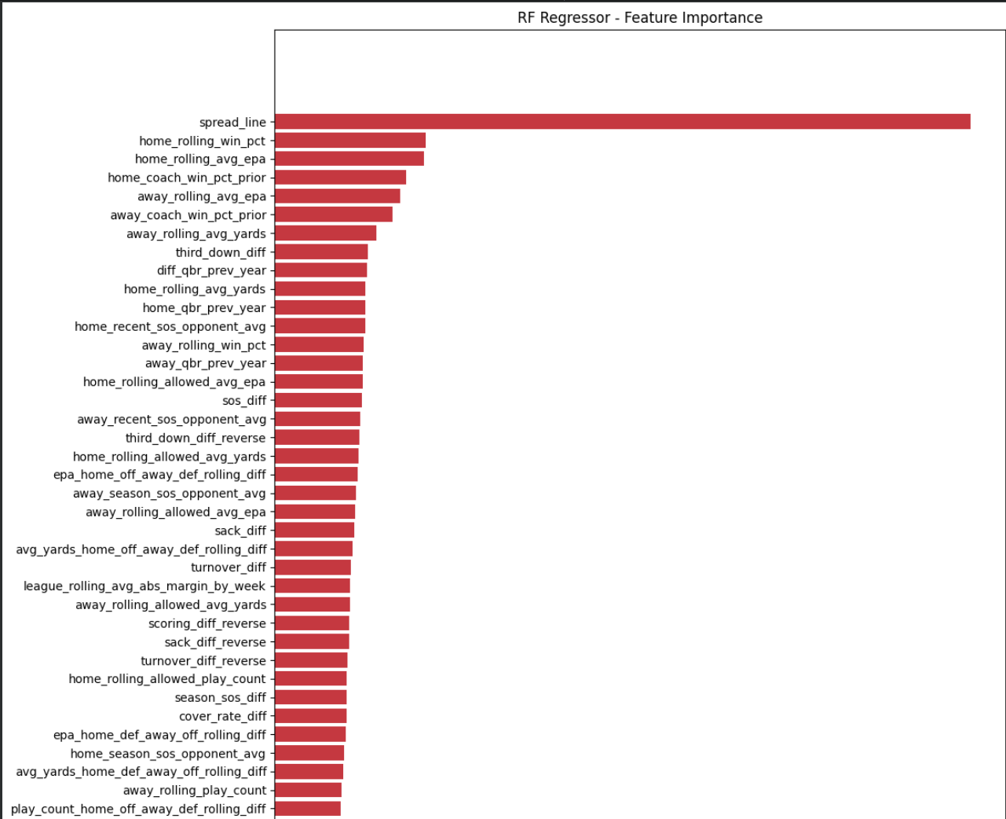

Slide 28
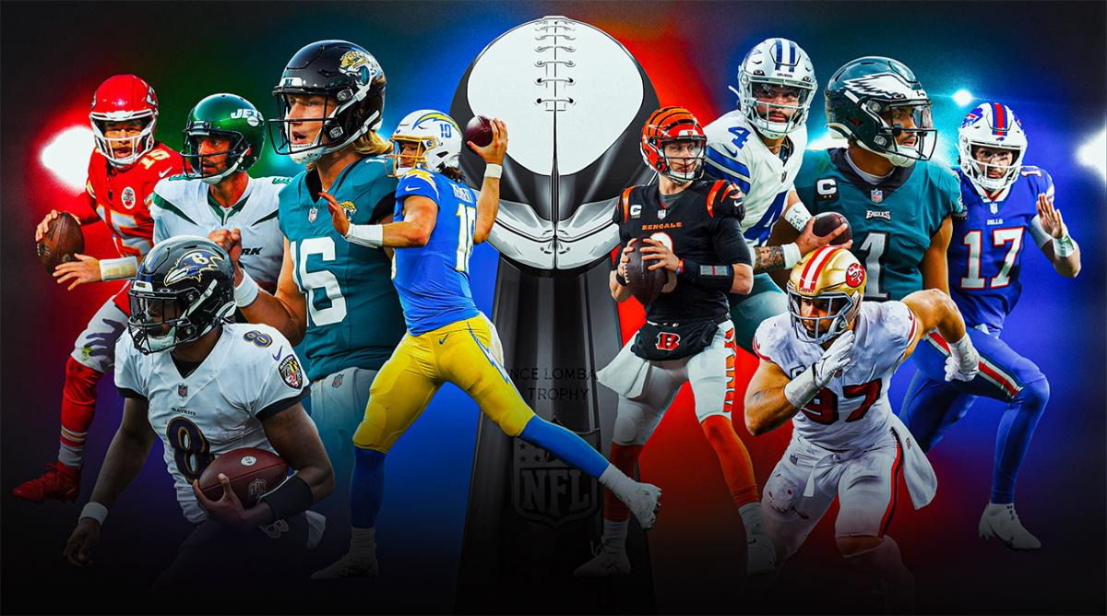
Comparison to 5 year data
2009-2025 is a long time
We looked at the most recent 5 years to see if the model performed any differently
The RF Regressor had a bet winning percentage of 47.55%, but had a differential of 1 betting percentage at 47.64%
So overall, slight decrease in performance

Slide 29
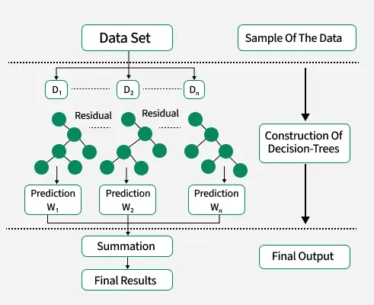
XGBoost Model
Why use an XgBoost Model?
Handles non-linear and noisy data well
Built in parameters to help reduce overfitting
Feature importance and weight
Custom sample weighting

Slide 30
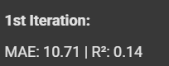
1st Iteration of the Model
All features, no hyperparameter tuning
Baseline results, overall it is better than our early feature model
80/20 Split used for each Iteration

Slide 31
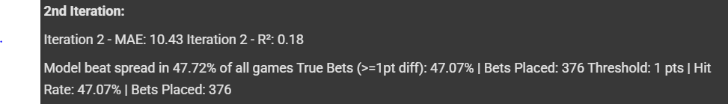
2nd Iteration of the Model
Hyperparameter tuning using GridsearchCV
Improved MAE and r-squared but bet % still low

Slide 32
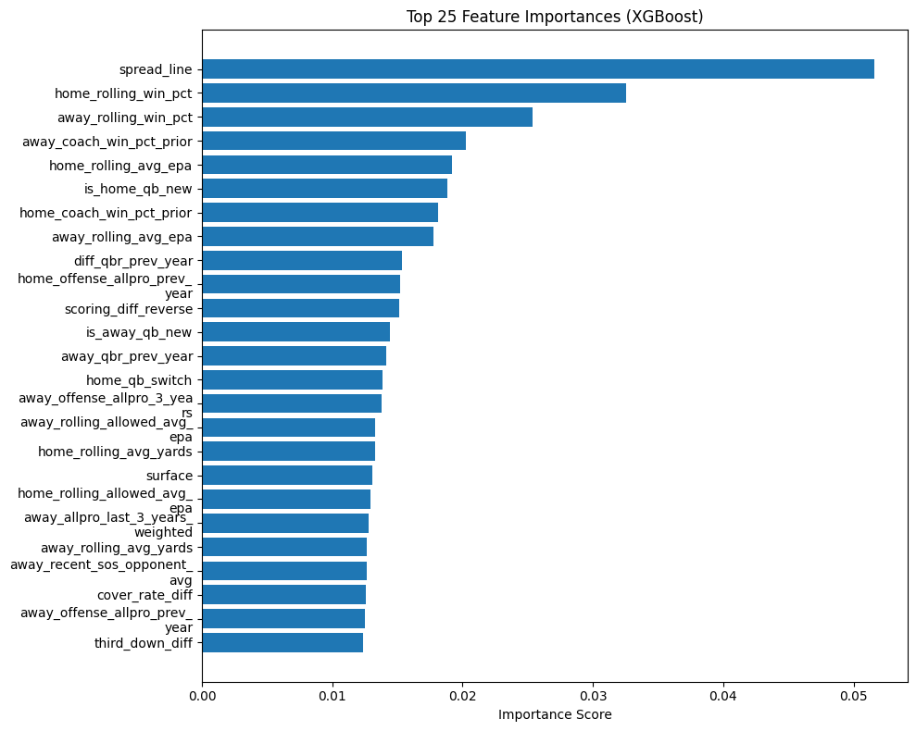

Slide 33
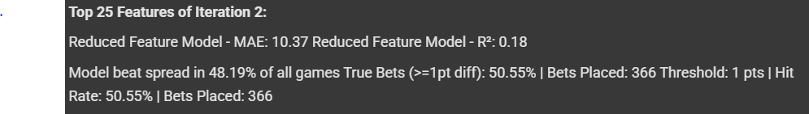
3rd Iteration of the Model
Reduced the Model to the Top 25 features
Kept same hyperparameters as iteration 2
Improved MAE slightly but bet % still below threshold

Slide 34
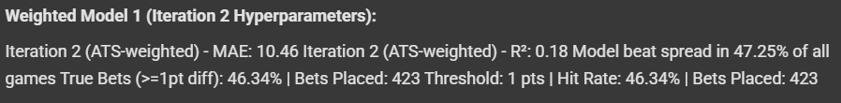
4th Iteration of the Model
Weighted bias towards game margins that would win Against the Spread (ATS)
win weight = 2 vs loss weight = 1
Kept same hyperparameters as iteration 2
Loss of MAE slightly and bet % still below threshold

Slide 35
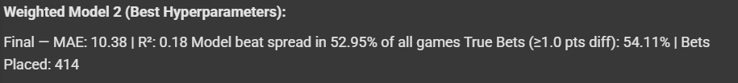
5th Iteration of the Model
Weighted ATS model
win weight = 2 vs loss weight = 1
Used new hyperparameters with GridsearchCV
MAE improves while r-squared stays consistent
Significant improvement on winning bet percentage

Slide 36
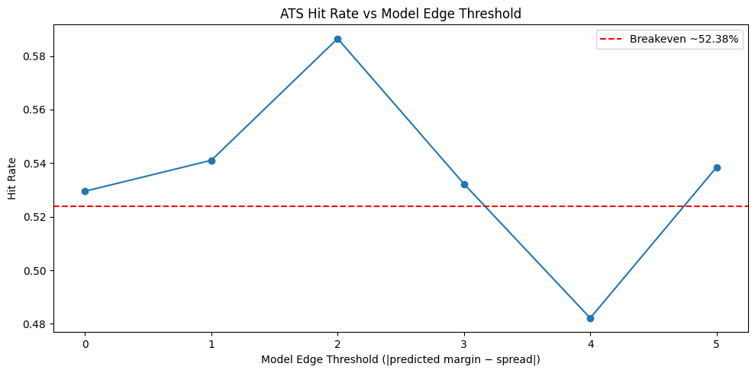
5th Iteration of the Model

Slide 37
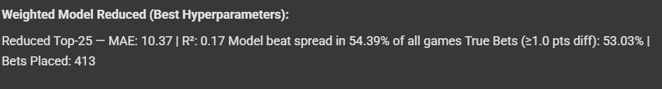
6th Iteration of the Model
Weighted ATS model
win weight = 2 vs loss weight = 1
Used new hyperparameters with GridsearchCV
Used the top 25 features from the second iteration
MAE improves while r-squared lowers
Improvement on winning bet percentage but loss on true bet

Slide 38
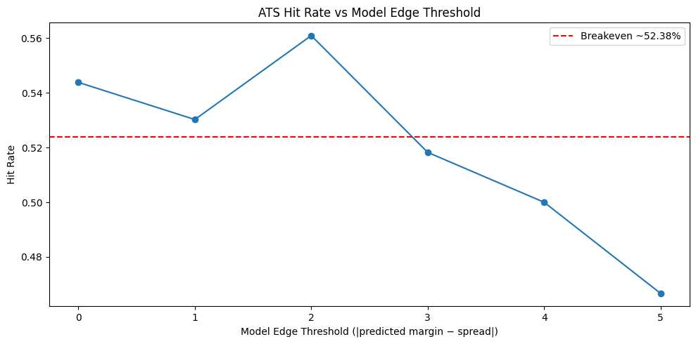
6th Iteration of the Model

Slide 39
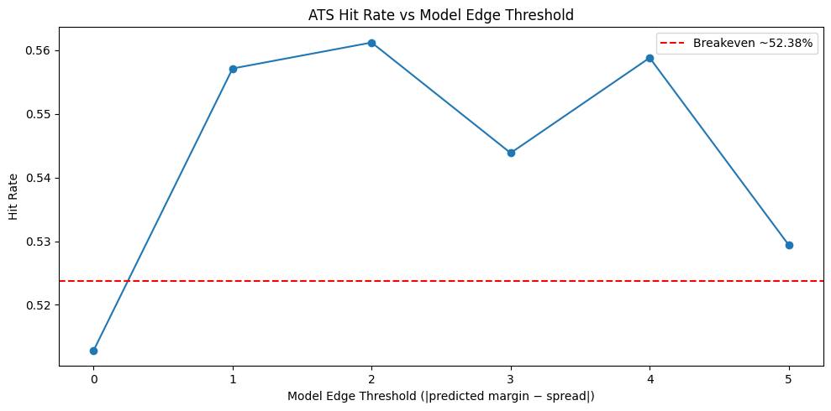
Comparison to 5 year data - Iteration 2
MAE dropped to 10.28 but r-squared is lower due to less sample size
51.28% for all games but has 55.71% for true bets
Better performance overall

Slide 40
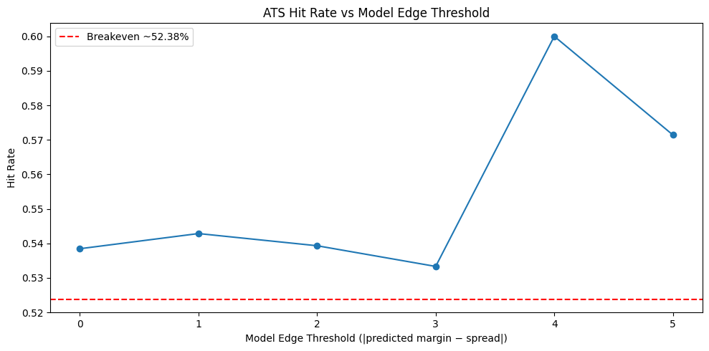
Comparison to 5 year data - Iteration 5
MAE dropped to 10.34 but r-squared is 0.07
53.85% for all games but has 54.29% for true bets
Better performance overall and broke threshold with all bets made

Slide 41
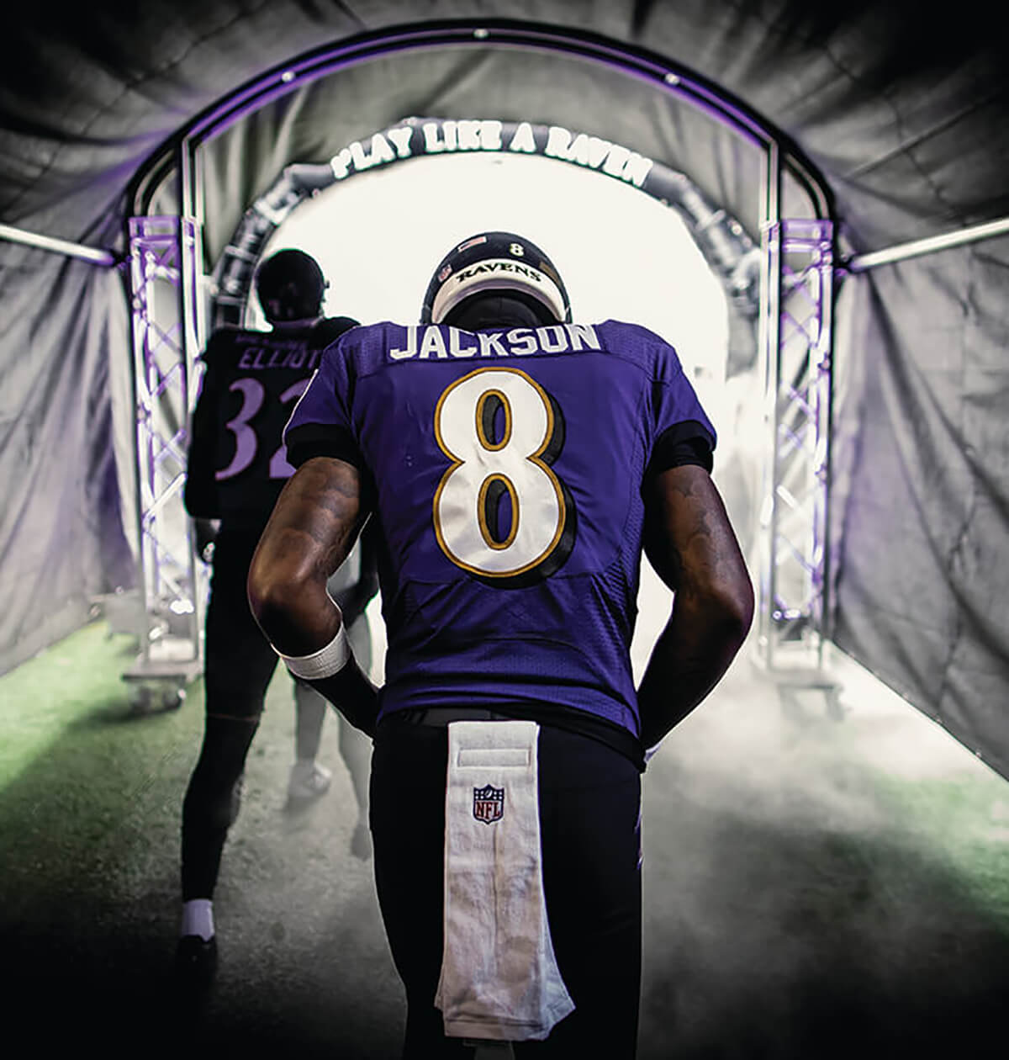
Takeaways
Sporting events such as football are extremely noisy and random
Getting a model that can have a bet winning percentage around ~50% is decent
Ideally, to break even you want at least a 52.38% win rate
A model with around 55% is above average performance
Features are the most important part of improving the model

Slide 42
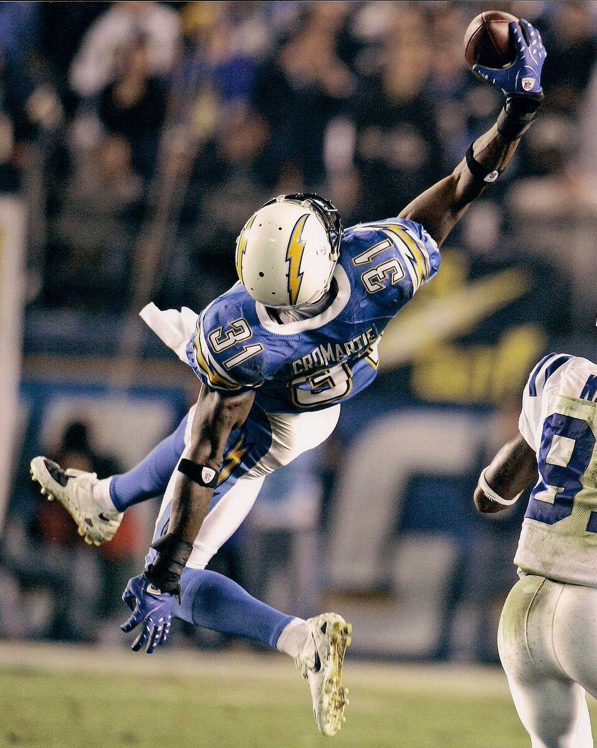
Takeaways Cont.
Including the spread line greatly improved our model
Changing our the start of our data from 2000 to 2009 allowed us to use more robust data, create better features and improve our model
Check parameters after features are improved or added

Slide 43



Potential Steps Forward
Continue Adding Features
Look into more niche cases
Create UI to bet on real upcoming matches

Slide 44
References
NFL_Data_py dataset - https://pypi.org/project/nfl-data-py/
All-pro dataset - https://www.pro-football-reference.com/years/2024/allpro.htm
Spread line data - https://www.kaggle.com/datasets/tobycrabtree/nfl-scores-and-betting-data?select=spreadspoke_scores.csv

Slide 45
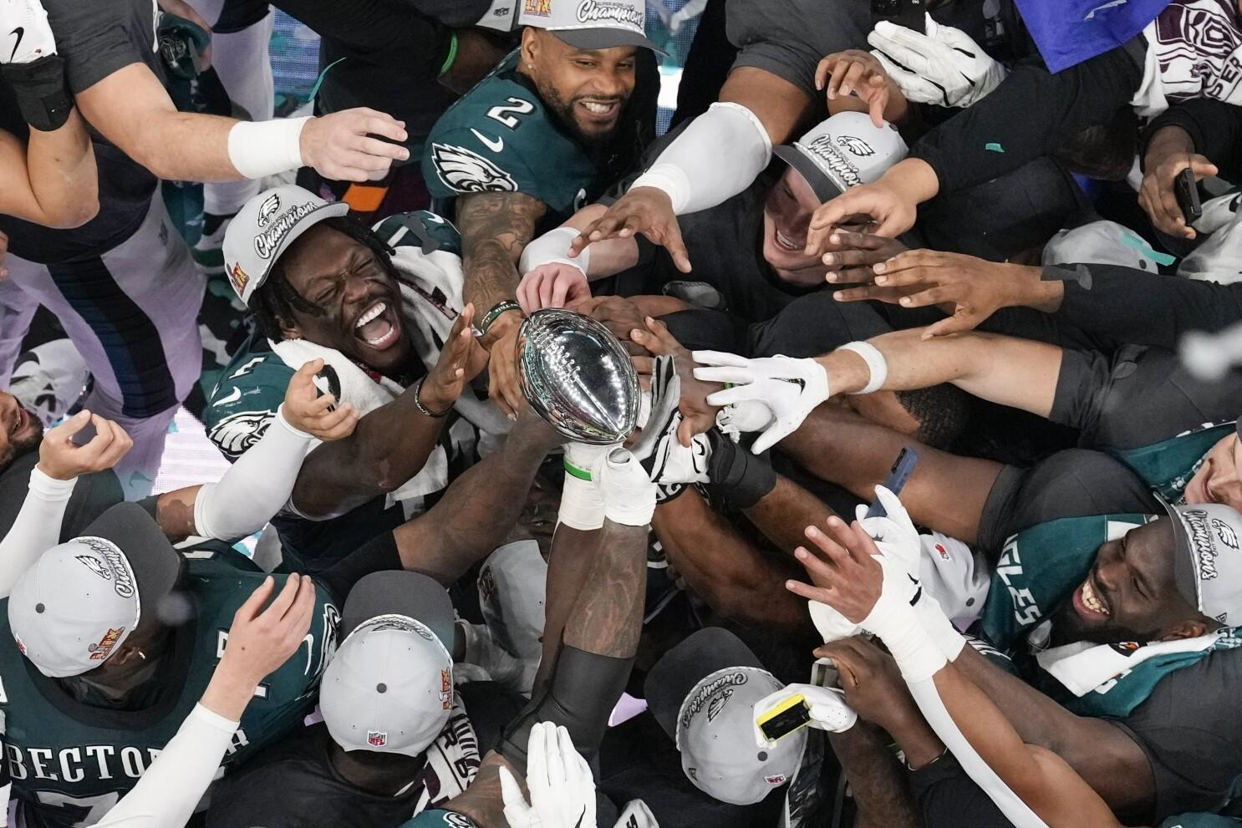
Q&A

